Slide 1
Give Me Some Credit
葛浩 3180103494 朱祉盈 3180103536

Slide 2
Overview

Slide 3
Overview
Problem Statement
Improve on the state of the art in credit scoring by predicting the probability that somebody will experience financial distress in the next two years.
Our Goal
On a given test set, predict the possibility of future financial distress(Y/N)

Slide 4
Overview
Problem Statement
Improve on the state of the art in credit scoring by predicting the probability that somebody will experience financial distress in the next two years.
Our Goal
On a given test set, predict the possibility of future financial distress(Y/N)

Slide 5
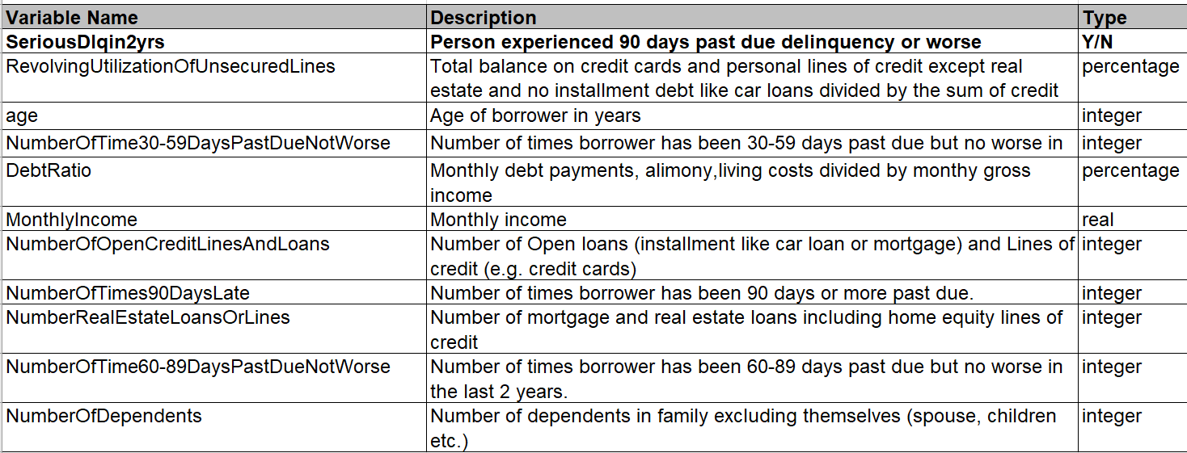
Overview
Details about the dataset
13 inputs: features indicating costumer’s financial condition
1 output : whether meet over 90 days past due (Y/N)
Specific data dictionary

Slide 6
Data Cleaning

Slide 7
Data Cleaning
Data Preprocessing
Feature Engineering

Slide 8
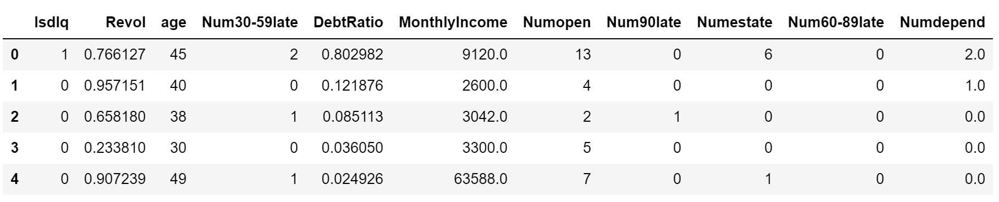
Data Cleaning |Analysis
drop unnamed columns & rename remaining columns

Slide 9
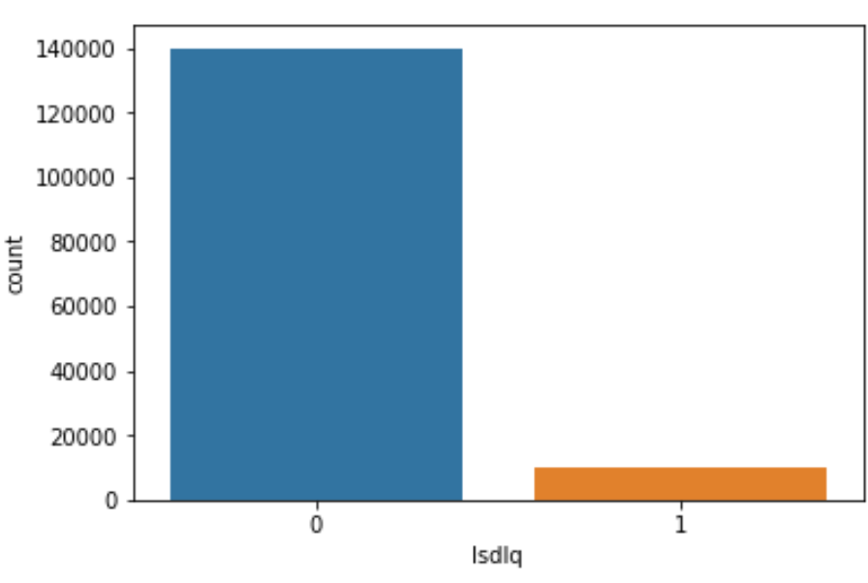
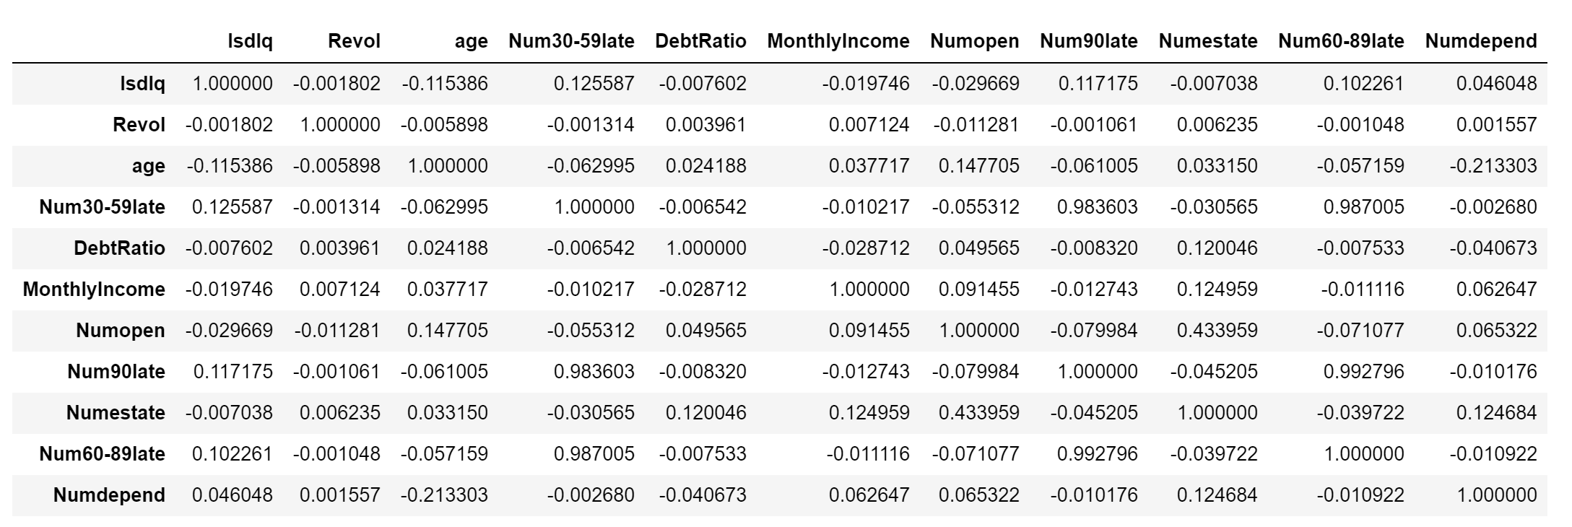
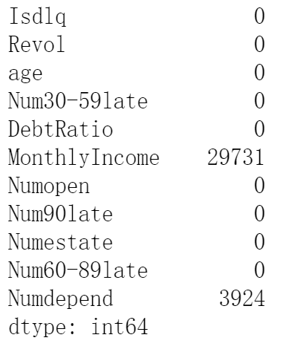
Data Cleaning | Analysis
Y/N ratio in training set
Missing Values
Correlation Matrix
-> potential noises and unbalance in data
-> For missing values, no need to delete the whole row

Slide 10
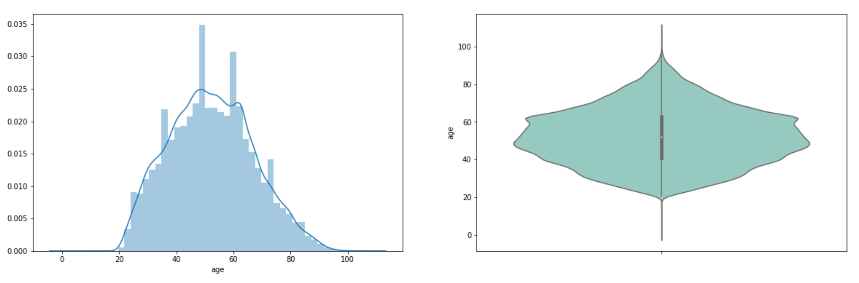
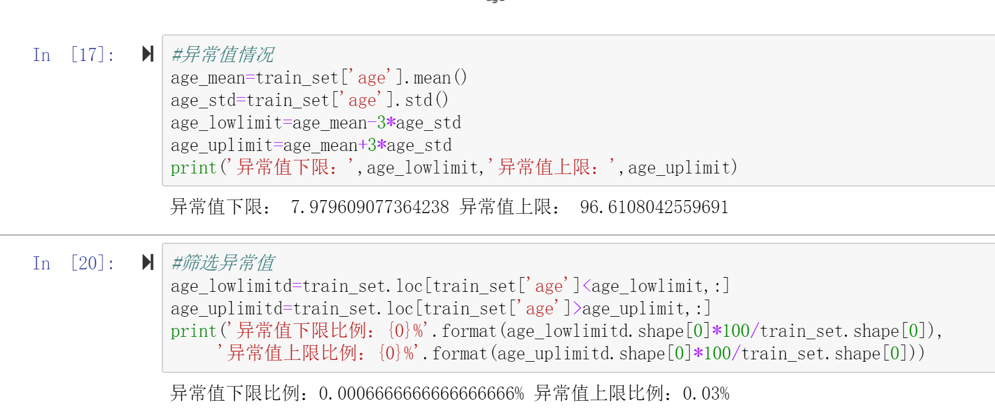
Data Cleaning | Analysis
Look at Each Attribute
Age distribution
-> approximately fit normal distribution
-> calculate abnormal bound accordingly

Slide 11
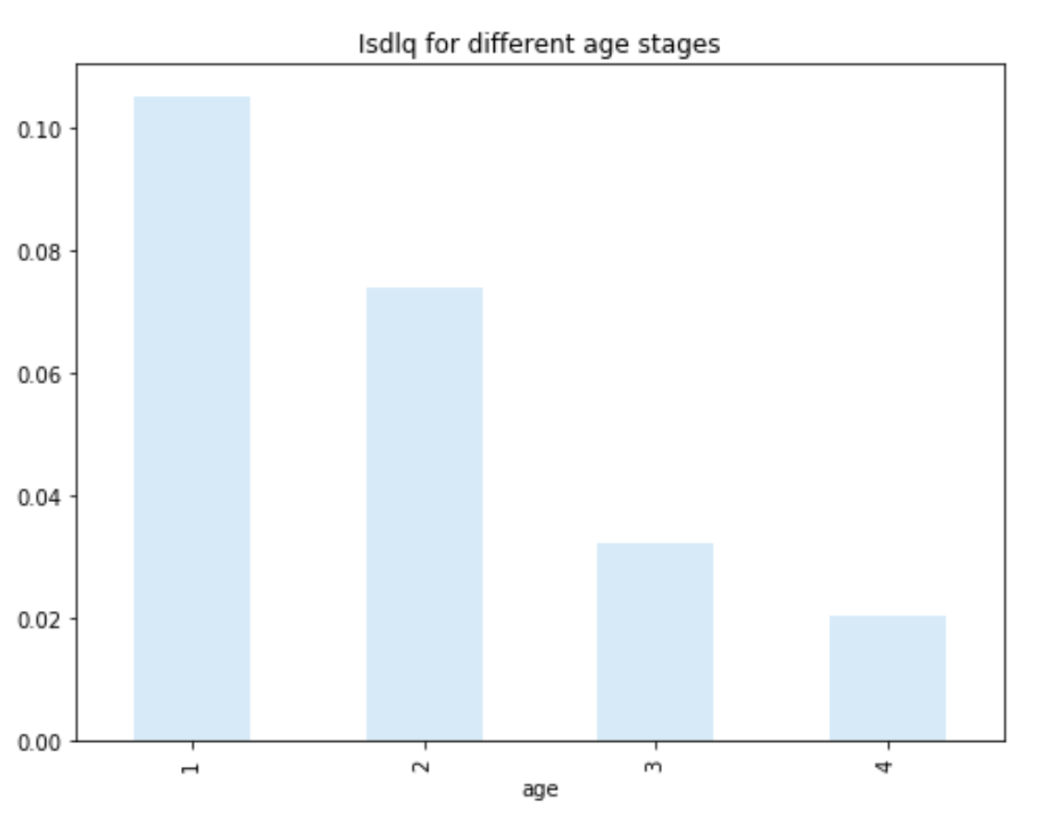
Data Cleaning | Analysis
Look at Each Attribute
Age
use histogram to reveal the relation between age
and result
-> default rates decrease with age
-> 18-40 is the age stage with highest default rate

Slide 12
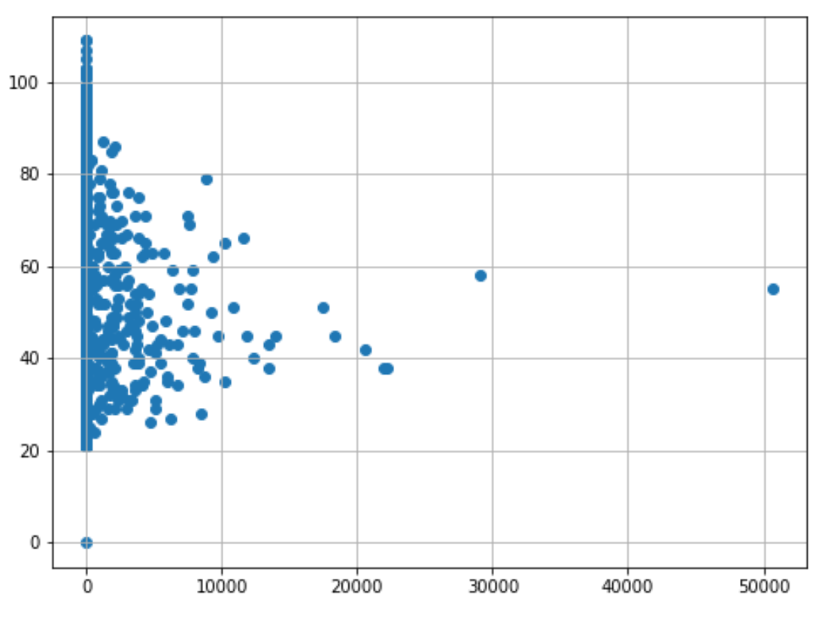
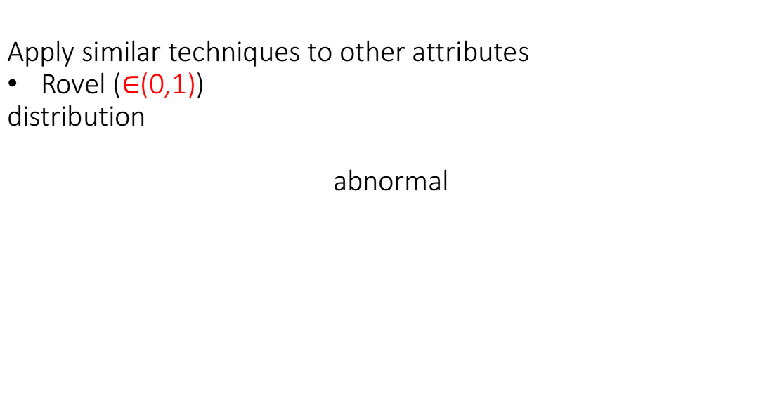
Data Cleaning | Analysis
Apply similar techniques to other attributes
Rovel ($∈$(0,1))
distribution
abnormal
Notes:
正常来讲Revol的取值在0-1之间，超出1表明透支。但从上图看出有些数据超过10000，猜想可能有一部份数值为未除以分母信用卡额度，我们需要筛选出哪些数据是这种情况

Slide 13
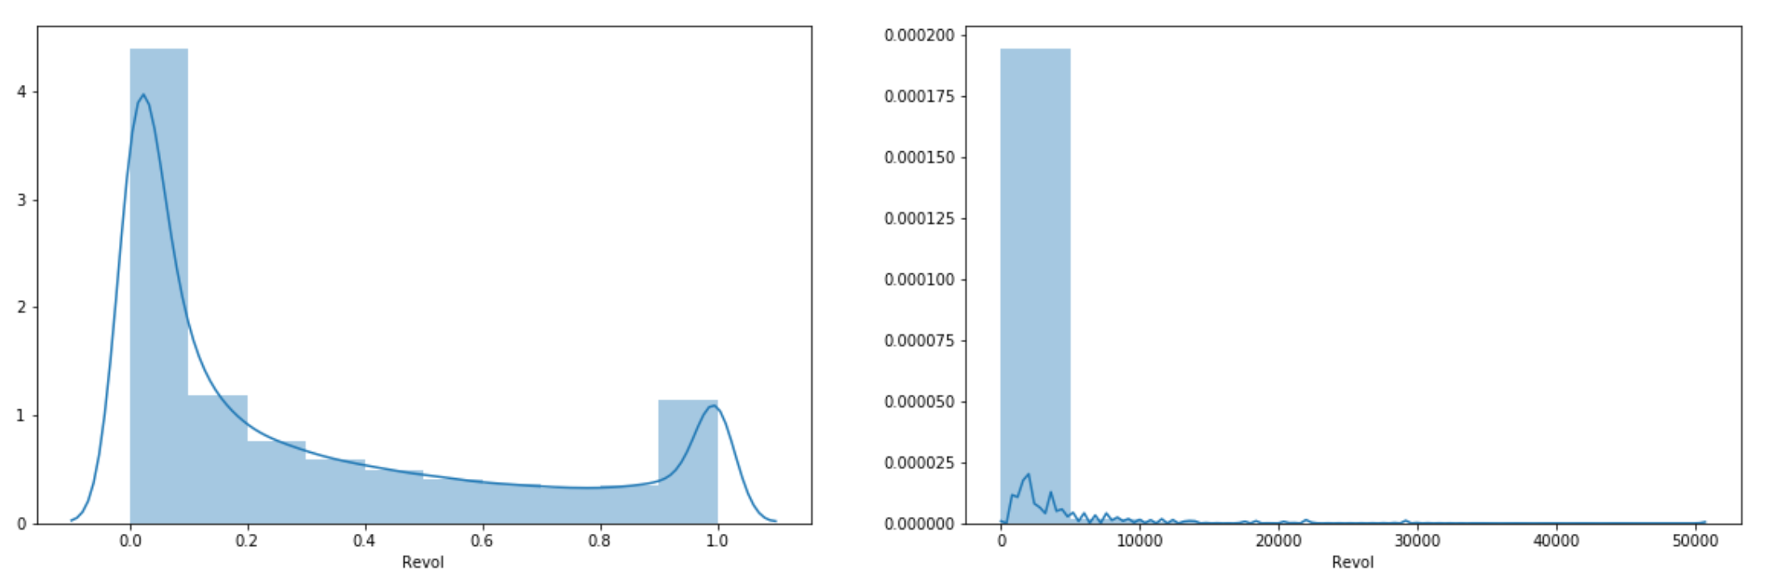
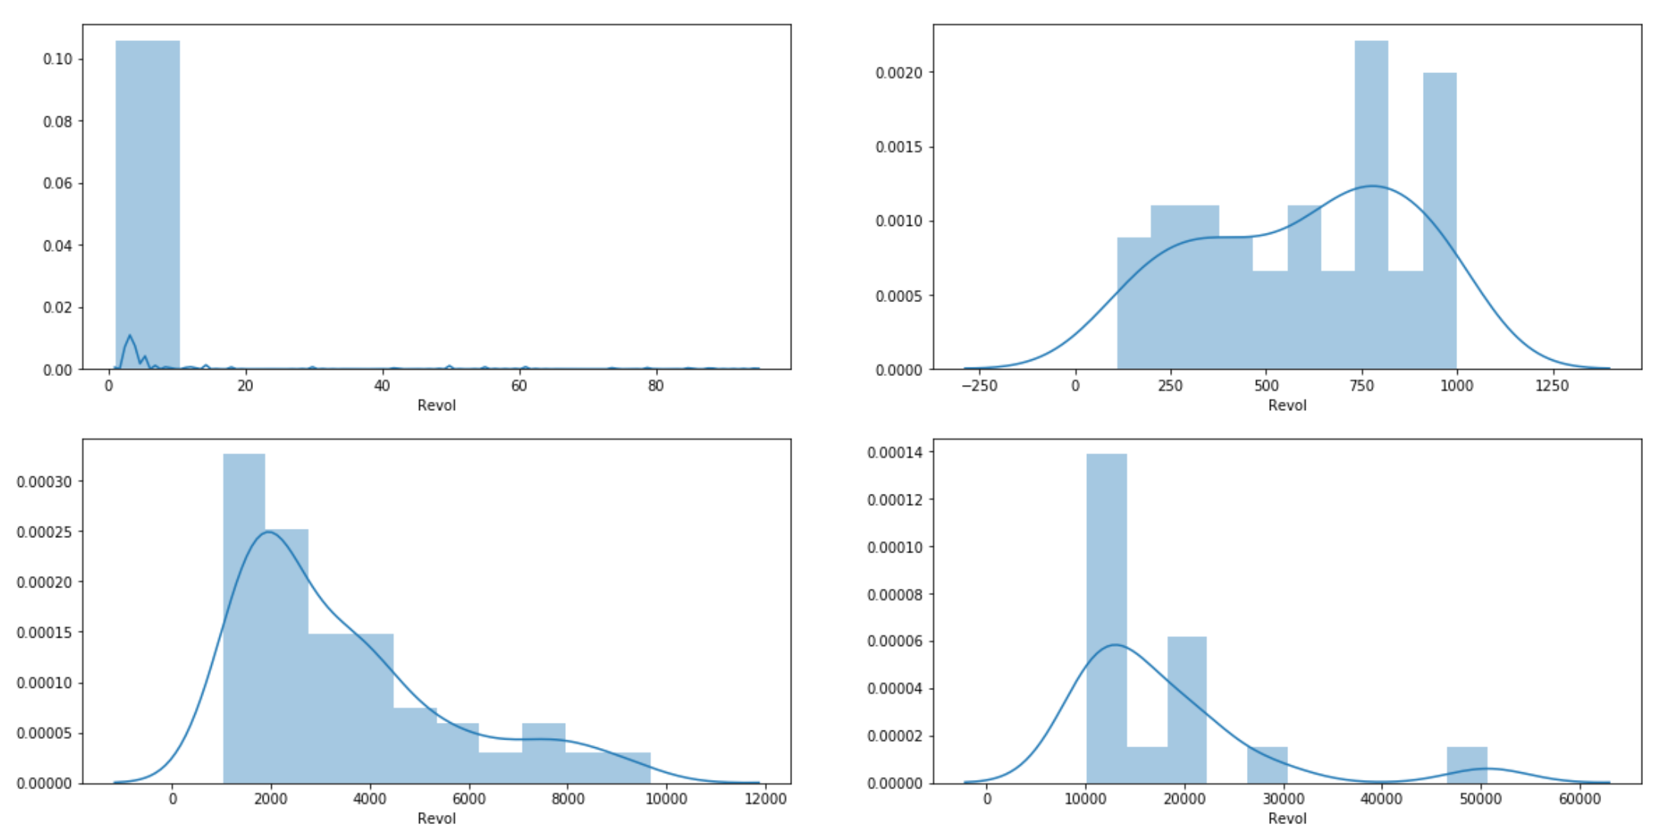

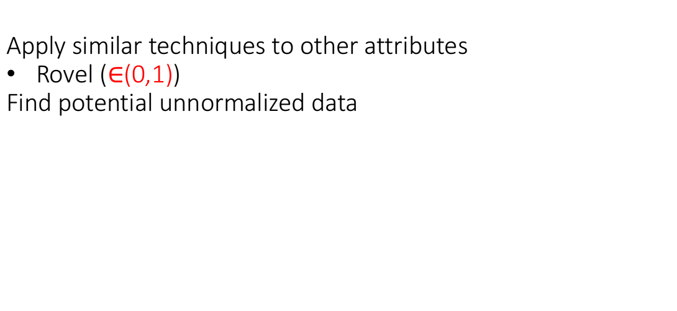
Data Cleaning | Analysis
Apply similar techniques to other attributes
Rovel ($∈$(0,1))
Find potential unnormalized data
->threshold for abnormal values is about 20
Notes:
因数据分布跨度比较大，我们将数据分为两部分，小于1和大于1的部分，来看一下两部分的数据分布。看一下实际情况。
可以看出在Revol大于1时，违约率开始上升，10-20之间违约率达到高峰，超过20后开始下降，超过1000后开始恢复正常（与0-1的违约率一致），说明20左右的值可能为异常值上限的阈值。可以将超过20的值都定义为异常值。

Slide 14
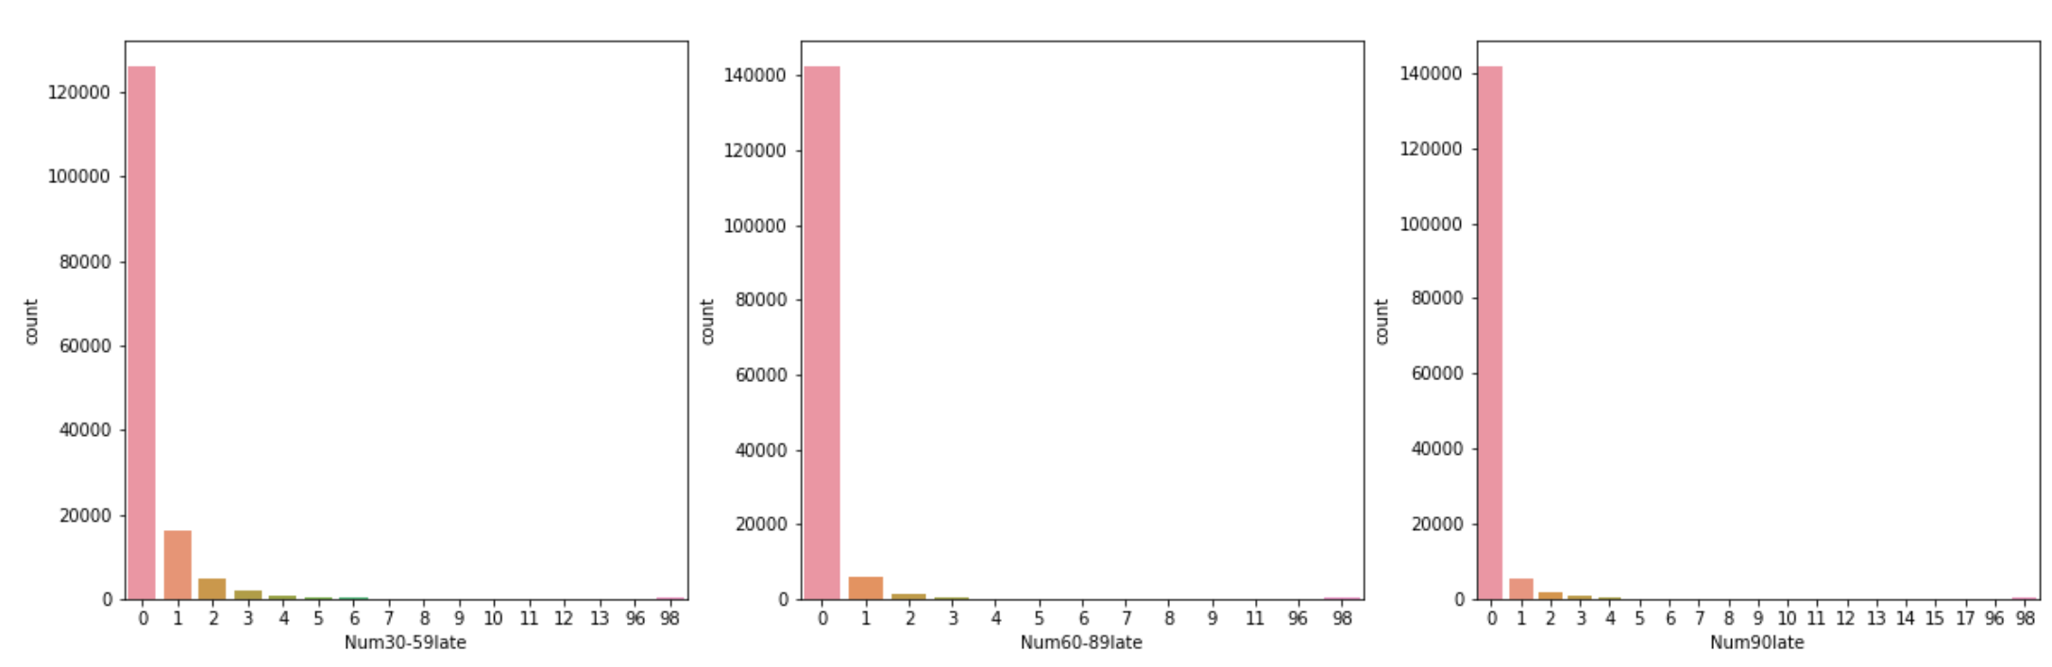
Data Cleaning | Analysis
Apply similar techniques to other attributes
Num30-59late Num60-89late Num90late
abnormal
Notes:
从图表可见超过90的是异常数据

Slide 15
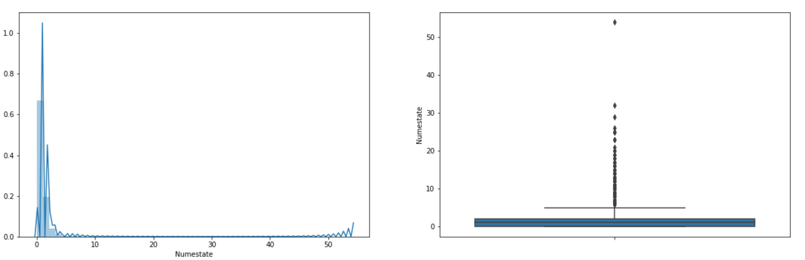
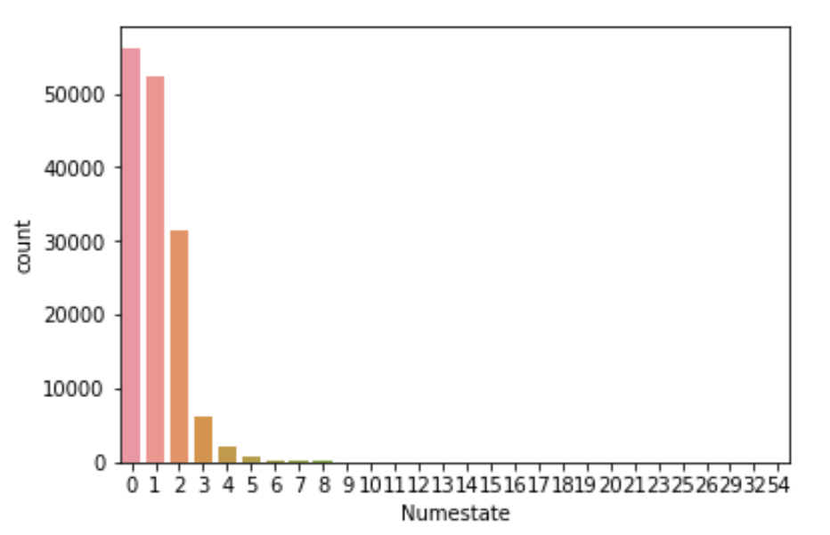
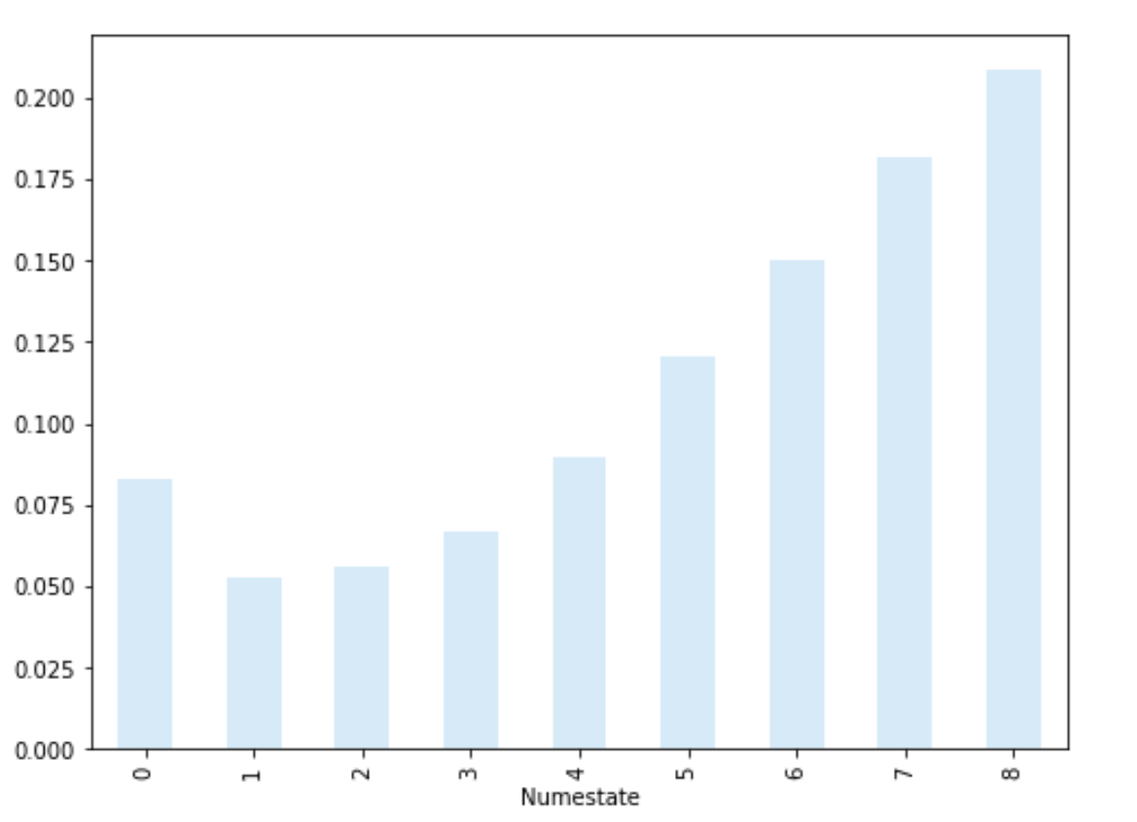
Data Cleaning | Analysis
Apply similar techniques to other attributes
numstate Distribution
Relation with y

Slide 16
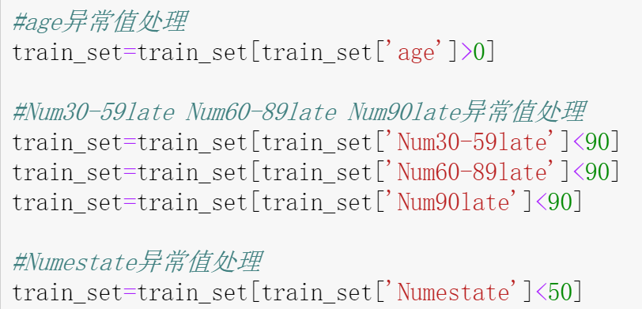
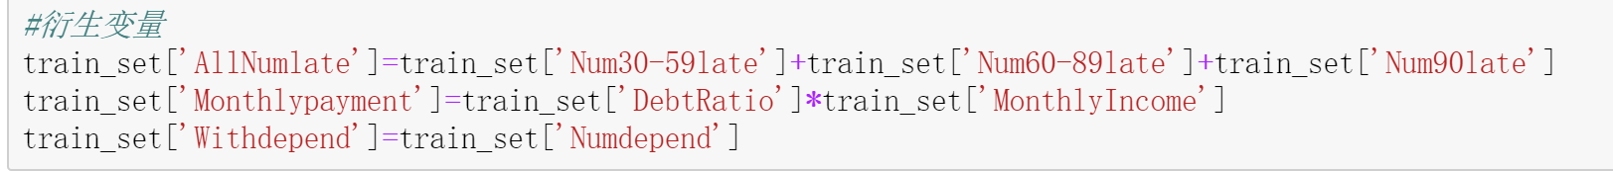
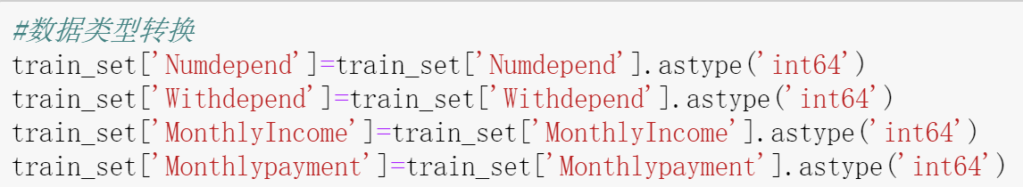
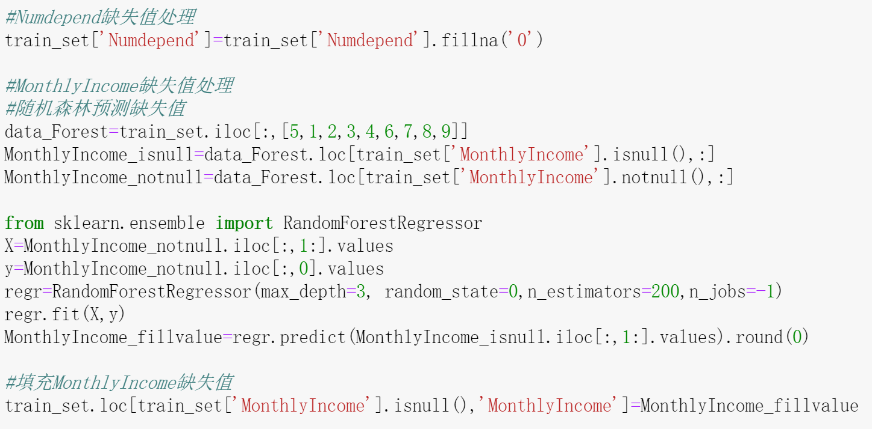
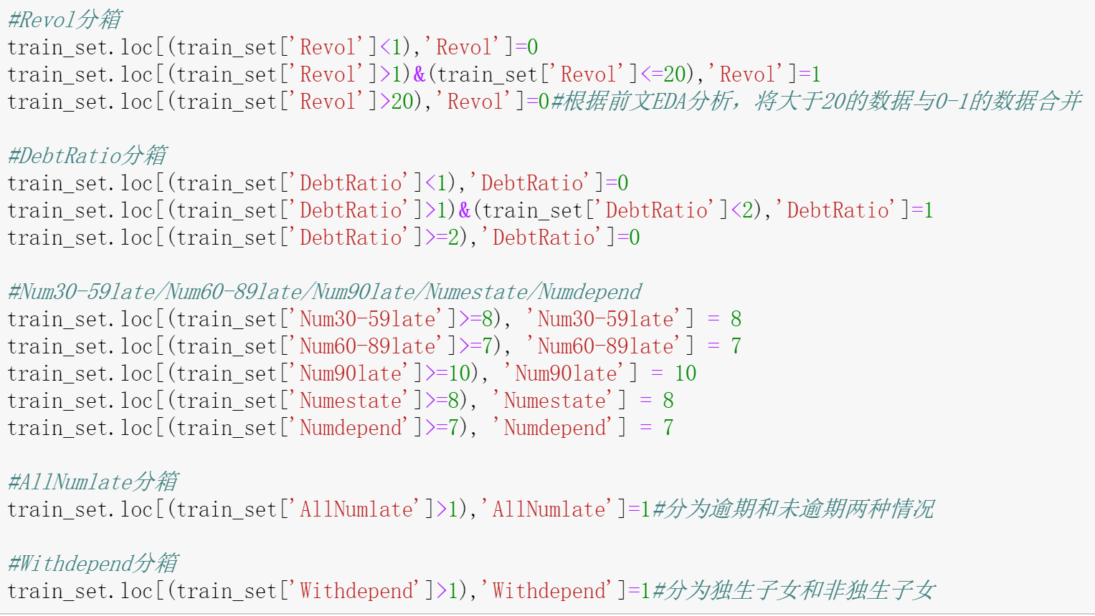
Data Cleaning |Feature Engineering
feature crossing
adjust data type
Binning
Preprocessing Feature Extraction and Binning
abnormal values
missing values

Slide 17
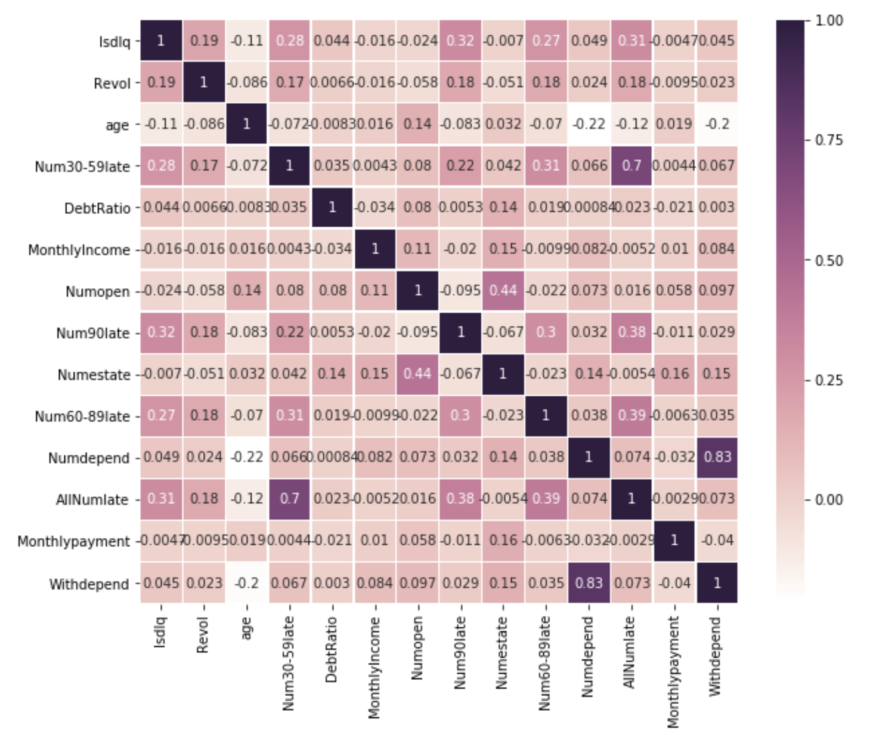
Data Cleaning |Feature Selection
Use heatmap to visualize the new correlation matrix

Slide 18
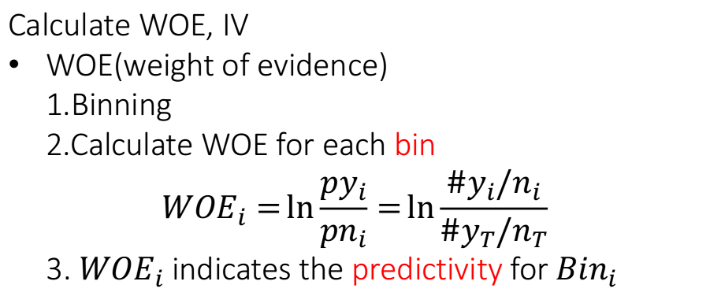
Data Cleaning |Feature Selection
Calculate WOE, IV
WOE(weight of evidence)
1.Binning
2.Calculate WOE for each bin
$${WOE}_{i}=\ln{\frac{{py}_{i}}{{pn}_{i}}=\ln{\frac{{\#y}_{i}/n_{i}}{{\#y}_{T}/n_{T}}}}$$
3. ${WOE}_{i}$ indicates the predictivity for ${Bin}_{i}$

Slide 19
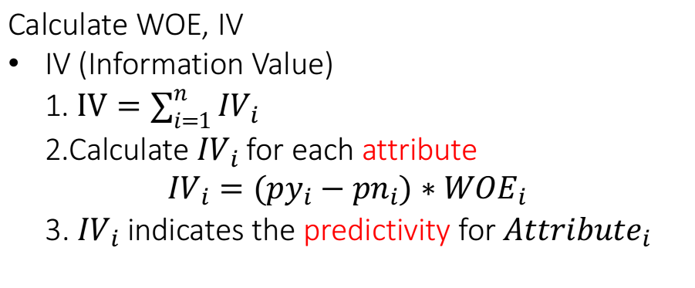
Data Cleaning |Feature Selection
Calculate WOE, IV
IV (Information Value)
1. $IV=\sum_{i=1}^{n}{{IV}_{i}}$
2.Calculate ${IV}_{i}$for each attribute
$${IV}_{i}={(py}_{i}−{pn}_{i})∗{WOE}_{i}$$
3. ${IV}_{i}$ indicates the predictivity for ${Attribute}_{i}$

Slide 20
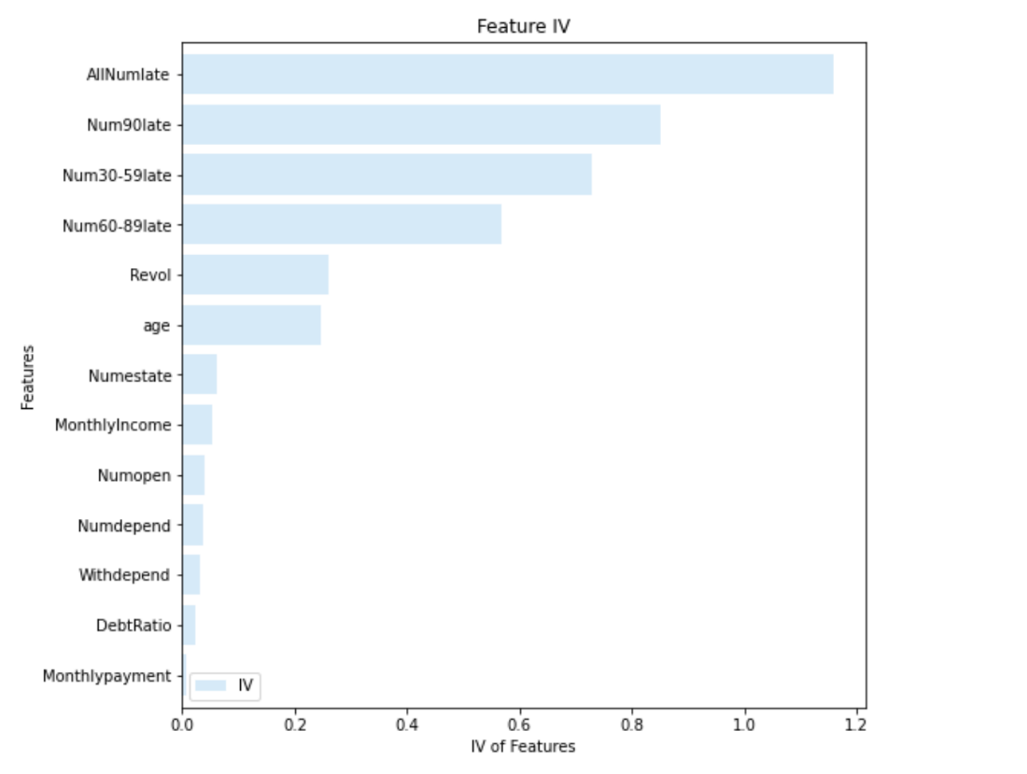
Data Cleaning |Feature Selection
Visualize IV of every attribute
Filter out variables with IV values greater than 0.1：'Num30-59late'，'Num60-89late'，'Num90late'，'AllNumlate'，'Revol'，'age'；
There is a strong correlation between‘Num30-59late’ and‘AllNumlate’ (0.7). Choose the one with higher IV ('AllNumlate’)
Final choice:
['Num60- 89late','Num90late’,'AllNumlate',’ Revol','age']

Slide 21
Model and Idea Introduction

Slide 22
from Logistic Regression to Deep Learning
从逻辑回归到深度学习到自编码，主要介绍创新点的灵感来源

Slide 23
Logistic Regression

Slide 24
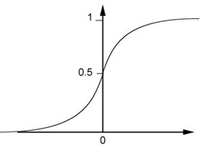

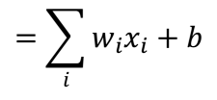
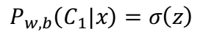
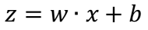
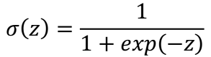

Step 1: Function Set
Function set:
Including all different w and b
$$P_{w,b}\left(C_{1}|x\right)≥0.5$$
class 1
z
0
$$P_{w,b}\left(C_{1}|x\right)<0.5$$
class 2
z
0
$$P_{w,b}\left(C_{1}|x\right)=σ\left(z\right)$$
$$=\sum_{i}{w_{i}x_{i}}+b$$
$$z=w∙x+b$$
$$σ\left(z\right)=\frac{1}{1+exp\left(−z\right)}$$
Notes:
这里的function set就是Logistic Regression——逻辑回归

Slide 25
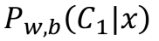
Step 1: Function Set
…
…
$$P_{w,b}\left(C_{1}|x\right)$$
…
…
Sigmoid Function
Notes:
sigmoid function其实就是Activation function

Slide 26
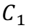

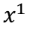


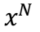

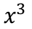

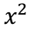

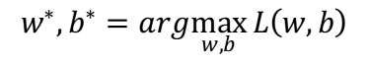
Step 2: Goodness of a Function
Training
Data
$$x^{1}$$
$$x^{2}$$
$$x^{3}$$
$$x^{N}$$
$$……$$
$$C_{1}$$
$$C_{1}$$
$$C_{2}$$
$$C_{1}$$
Assume the data is generated based on $f_{w,b}\left(x\right)=P_{w,b}\left(C_{1}|x\right)$
Given a set of w and b, what is its probability of generating the data?
$$L\left(w,b\right)=f_{w,b}\left(x^{1}\right)f_{w,b}\left(x^{2}\right)\left(1−f_{w,b}\left(x^{3}\right)\right)⋯f_{w,b}\left(x^{N}\right)$$
The most likely w* and b* is the one with the largest $L\left(w,b\right)$.
$$w^{∗},b^{∗}=arg\max_{w,b}{L\left(w,b\right)}$$
Notes:
现在我们有N笔Training data，每一笔data都要标注它是属于哪一个class
假设这些Training data是从之前我们定义的posterior Probability中产生的(后置概率，某种意义上就是概率密度函数)，而w和b就决定了这个posterior Probability，那我们就可以去计算某一组w和b去产生这N笔Training data的概率，利用极大似然估计的思想，最好的那组参数就是有最大可能性产生当前N笔Training data分布的w*和b*
似然函数只需要将每一个点产生的概率相乘即可，注意，这里假定是二元分类，class 2的概率为1减去class 1的概率

Slide 27
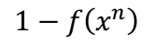
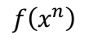
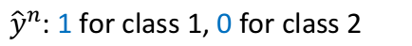
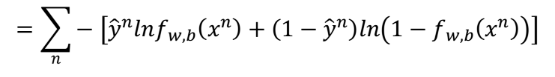

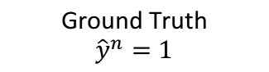
Step 2: Goodness of a Function
$$L\left(w,b\right)=f_{w,b}\left(x^{1}\right)f_{w,b}\left(x^{2}\right)\left(1−f_{w,b}\left(x^{3}\right)\right)⋯f_{w,b}\left(x^{N}\right)$$
$$−lnL\left(w,b\right)=lnf_{w,b}\left(x^{1}\right)+lnf_{w,b}\left(x^{2}\right)+ln\left(1−f_{w,b}\left(x^{3}\right)\right)⋯$$
${\hat{y}}^{n}$: 1 for class 1, 0 for class 2
$$=\sum_{n}{−\left[{\hat{y}}^{n}lnf_{w,b}\left(x^{n}\right)+\left(1−{\hat{y}}^{n}\right)ln\left(1−f_{w,b}\left(x^{n}\right)\right)\right]}$$
Cross entropy between two Bernoulli distribution
minimize
1.0
$$f\left(x^{n}\right)$$
0.0
cross entropy
$$1−f\left(x^{n}\right)$$
Ground Truth
$${\hat{y}}^{n}=1$$
Notes:
这里x^n表示第n个样本点，y_hat^n表示第n个样本点的class标签(1表示class 1,0表示class 2)，最终这个summation的形式，里面其实是两个Bernouli distribution(两点分布)的cross entropy(交叉熵)
交叉熵实际上表达的是希望这个function的output和它的target越接近越好

Slide 28
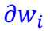
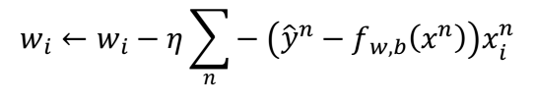


Step 3: Find the best function
Gradient:
$$−lnL\left(w,b\right)$$
$$=\sum_{n}{−\left({\hat{y}}^{n}−f_{w,b}\left(x^{n}\right)\right)x_{i}^{n}}$$
$$∂w_{i}$$
Gradient Descent:
$$w_{i}←w_{i}−η\sum_{n}{−\left({\hat{y}}^{n}−f_{w,b}\left(x^{n}\right)\right)x_{i}^{n}}$$
Larger difference, larger update
Notes:
实际上就是去找到使loss function即交叉熵之和最小的那组参数w*,b*就行了，这里用gradient descent的方法进行运算就ok
详细数学推导，展示时简略说明即可

Slide 29

Cross Entropy v.s. Square Error
Cross Entropy
Total
Loss
Square
Error
w₁
w₂
Notes:
对比交叉熵和均方根作为损失函数的情况：
如果我们把参数的变化对total loss作图的话，loss function选择cross entropy或square error，参数的变化跟loss的变化情况可视化出来：(黑色的是cross entropy，红色的是square error)
假设中心点就是距离目标很近的地方，如果是cross entropy的话，距离目标越远，微分值就越大，参数update的时候变化量就越大，迈出去的步伐也就越大；但当你选择square error的时候，过程就会很卡，因为距离目标远的时候，微分也是非常小的，移动的速度是非常慢的
综上，尽管square error可以使用，但是会出现update十分缓慢的现象，而使用cross entropy可以让你的Training更顺利

Slide 30




Logistic Regression
$$f_{w,b}\left(x\right)=σ\left(\sum_{i}{w_{i}x_{i}}+b\right)$$
Step 1:
Output: between 0 and 1
$$L\left(f\right)=\sum_{n}{l\left(f\left(x^{n}\right),{\hat{y}}^{n}\right)}$$
Training data: $\left(x^{n},{\hat{y}}^{n}\right)$
Step 2:
${\hat{y}}^{n}$: 1 for class 1, 0 for class 2
$$w_{i}←w_{i}−η\sum_{n}{−\left({\hat{y}}^{n}−f_{w,b}\left(x^{n}\right)\right)x_{i}^{n}}$$
Logistic regression:
Step 3:
Cross entropy:
$$l\left(f\left(x^{n}\right),{\hat{y}}^{n}\right)=−\left[{\hat{y}}^{n}lnf\left(x^{n}\right)+\left(1−{\hat{y}}^{n}\right)ln\left(1−f\left(x^{n}\right)\right)\right]$$
Notes:
逻辑回归小结

Slide 31



Limitation of Logistic Regression
$$(z≥0)$$
$$(z<0)$$
Can we?
Input Feature |  | Label
x₁ | x₂
0 | 0 | Class 2
0 | 1 | Class 1
1 | 0 | Class 1
1 | 1 | Class 2
z ≥ 0
z < 0
z < 0
z ≥ 0
Notes:
Logistic Regression其实有很强的限制，给出下图的例子中的Training data，想要用Logistic Regression对它进行分类，其实是做不到的
因为Logistic Regression在两个class之间的boundary就是一条直线，但是在这个平面上无论怎么画直线都不可能把图中的两个class分隔开来

Slide 32










Limitation of Logistic Regression
$x_{1}^{′}$: distance to $\left[\begin{aligned}0 \\ 0\end{aligned}\right]$
$x_{2}^{′}$: distance to $\left[\begin{aligned}1 \\ 1\end{aligned}\right]$
Feature transformation
$$\left[\begin{aligned}x_{1} \\ x_{2}\end{aligned}\right]$$
$$\left[\begin{aligned}x_{1}^{′} \\ x_{2}^{′}\end{aligned}\right]$$
Not always easy ….. domain knowledge can be helpful
$$x_{2}^{′}$$
$$\left[\begin{aligned}0 \\ \sqrt{2}\end{aligned}\right]$$
$$\left[\begin{aligned}0 \\ 1\end{aligned}\right]$$
$$\left[\begin{aligned}1 \\ 1\end{aligned}\right]$$
$$\left[\begin{aligned}0 \\ 0\end{aligned}\right]$$
$$\left[\begin{aligned}0 \\ 1\end{aligned}\right]$$
$$\left[\begin{aligned}1 \\ 1\end{aligned}\right]$$
$$\left[\begin{aligned}\sqrt{2} \\ 0\end{aligned}\right]$$
$$x_{1}^{′}$$
Notes:
如果坚持要用Logistic Regression的话，有一招叫做Feature Transformation，原来的feature分布不好划分，那我们可以将之转化以后，找一个比较好的feature space，让Logistic Regression能够处理
这就需要用比较好的特征工程和特征转换，可能需要专业领域的知识作为帮助

Slide 33
Limitation of Logistic Regression
Cascading logistic regression models
$$x_{1}^{′}$$
$$x_{2}^{′}$$
Feature Transformation
Classification
多个逻辑回归实际上就是在做特征转换
(ignore bias in this figure)
Notes:
但麻烦的是，我们并不知道怎么做feature Transformation，如果在这上面花费太多的时间就得不偿失了，于是我们会希望这个Transformation是机器自己产生的，怎么让机器自己产生呢？我们可以让很多Logistic Regression连接(cascade)起来

Slide 34











$x_{1}^{′}$=0.73
$x_{1}^{′}$=0.27
$$x_{1}^{′}$$
$x_{1}^{′}$=0.27
$x_{1}^{′}$=0.05
$$x_{2}^{′}$$
$x_{2}^{′}$=0.05
$x_{2}^{′}$=0.27
(0.73, 0.05)
$$x_{2}^{′}$$
(0.27, 0.27)
(0.05,0.73)
$x_{2}^{′}$=0.27
$x_{2}^{′}$=0.73
$$x_{1}^{′}$$
Notes:
此时就可以轻易的划分，而这个结构，实际上就是深度神经网络的基础

Slide 35


Deep Learning!
All the parameters of the logistic regressions are jointly learned.
“Neuron”
$$x_{1}^{′}$$
$$x_{2}^{′}$$
Feature Transformation
Classification
神经网络可以看做是多个逻辑回归连接的结果
Neural Network
Notes:
通过上面的例子，我们发现，多个Logistic Regression连接起来会产生powerful的效果，我们把每一个Logistic Regression叫做一个neuron(神经元)，把这些Logistic Regression串起来所形成的network，就叫做Neural Network，就是类神经网路，这个东西就是Deep Learning！

Slide 36
Deep Learning

Slide 37
Fully Connect Feedforward Network
1
4
0.98
1
-2
1
-1
-2
0.12
-1
1
0
Sigmoid Function
神经网络可以看做是激活函数为sigmoid的逻辑回归
Notes:
全连接的神经网络

Slide 38
Fully Connect Feedforward Network
neuron
Input
Layer 1
Layer 2
Layer L
Output
……
y₁
……
y₂
……
……
……
……
……
……
y_{M}
Input Layer
Output Layer
Hidden Layers
神经网络的隐藏层本质上就是特征提取器
Notes:
输入层、隐藏层、输出层

Slide 39
Output Layer as Multi-Class Classifier
Feature extractor replacing feature engineering
……
y₁
……
y₂
Softmax
……
……
……
……
……
……
y_{M}
Input Layer
Output Layer
= Multi-class Classifier
Hidden Layers
神经网络的隐藏层本质上就是特征提取器
Notes:
隐藏层代替人工做特征工程，最终通过softmax形成多分类器
我们是否可以不用神经网络作为最终的分类器，而仅仅使用神经网络提取出来的特征呢？这似乎提供了特征工程的一种新思路

Slide 40
Auto-Encoder for feature engineer
创新点：尝试利用autoencoder实现特征工程 利用神经网络提取特征
Notes:
尝试创新点：利用autoencoder来自动做特征工程，提取有用的潜在特征

Slide 41




Auto-encoder
Minimize
$${\left(x−\hat{x} \right)}^{2}$$
As close as possible
…
encode
decode
$$x$$
$$c$$
$$\hat{x}$$
…
hidden layer
Input layer
output layer
Bottleneck later
Output of the hidden layer is the feature
Notes:
中间隐藏层的输出就是特征工程提取的结果

Slide 42
Experiment Result Analysis

Slide 43


Lightgbm
model:
result:
不加自编码的特征工程在模型上的结果

Slide 44


Random Forest
model:
result:
不加自编码的特征工程在模型上的结果

Slide 45


Logistic Regression
model:
result:
不加自编码的特征工程在模型上的结果

Slide 46


Make Score Cards
Take logistic regression as an example
Result

Slide 47
Performance
with common feature engineering
model:
lightgbm < LR < random forest
result:
81.75 < 81.77 < 81.78
the performance is nearly the same, but it’s not the end!
we’ll try WOE+Auto-Encoder to make new feature extractor!
不加自编码的特征工程在模型上的结果

Slide 48

New Idea
we’ll try WOE+Auto-Encoder to
make new feature extractor!
初步特征工程+WOE编码后得到的13个特征
神经网络自编码进一步提取为3个特征
13
$$\hat{x}$$
3个特征还原为13个特征
W¹’
3
W¹
13个特征压缩为3个特征
13
$$x$$
最终提取到的新特征
创新点：WOE编码+Autoencoder=New Feature

Slide 49


New Idea
we’ll try WOE+Auto-Encoder to
make new feature extractor!
WOE编码+Auto-encoder
13-dimension -> 3-dimension
三维特征空间可视化
最终提取到的新特征
13
$$\hat{x}$$
W¹’
3
W¹
13
$$x$$
创新点：WOE编码+Autoencoder=New Feature

Slide 50

New Idea
we’ll try WOE+Auto-Encoder to
make new feature extractor!
WOE编码+Auto-encoder
13-dimension -> 3-dimension
三维特征空间可视化
最终提取到的新特征
13
$$\hat{x}$$
W¹’
3
W¹
13
$$x$$
创新点：WOE编码+Autoencoder=New Feature

Slide 51
New Idea
we’ll try WOE+Auto-Encoder to
make new feature extractor!
WOE编码+Auto-encoder
13-dimension -> 3-dimension
三维特征空间可视化
分类效果较为明显!
创新点：WOE编码+Autoencoder=New Feature

Slide 52

New Idea
we’ll try WOE+Auto-Encoder to
make new feature extractor!
WOE编码+Auto-encoder
13-dimension -> 3-dimension
三维特征空间可视化
implement with
PyTorch
Auto-encoder神经网络实现示意图：
创新点：WOE编码+Autoencoder=New Feature

Slide 53




Performance with New Idea
相同参数的模型
+
不同的特征工程
old
new
Lightgbm:
1%~3% ↑
Random Forest:
1%~3% ↑
Logistic Regression:
3%~4% ↓
WOE + Auto-Encoder在 相同模型上的结果对比

Slide 54
Performance with New Idea
相同参数的模型 + 不同的特征工程
Lightgbm:
1%~3% ↑
WOE编码+Auto-encoder的特征工程对树模型的性能改进贡献了一定的作用!
Random Forest:
1%~3% ↑
Logistic Regression:
3%~4% ↓
WOE + Auto-Encoder在 相同模型上的结果对比

Slide 55


Performance with New Idea
DNN Classifier (simple implement)
神经网络分类器
Mean Square Error
Adam (lr=0.01)
WOE + Auto-Encoder在DNN上的结果

Slide 56

Performance with New Idea
DNN Classifier (simple implement)
神经网络分类器
Mean Square Error
result:
Adam (lr=0.01)
WOE + Auto-Encoder在DNN上的结果

Slide 57
Performance Compare
WOE + Auto-encoder
DNN classifier:
Lightgbm:
1%~3% ↑
Random Forest:
1%~3% ↑
Logistic Regression:
3%~4% ↓
WOE + Auto-Encoder在 不同模型上的结果对比

Slide 58



Final Choice
13
$$\hat{x}$$
W¹’
WOE + Auto-encoder
3
W¹
13
$$x$$
+
LightGBM

Slide 59
Thanks

